Slide 1

machine Learning → face clustering
Guided by :
Prof. Dr. B.D.K Patro
Rajkiya Engineering
College , Kannauj
Presented by :
Abhay Kumar Awasthi
C.S.E 2nd year
REC Kannauj

Slide 2

AGENDA
Introduction
Biometrics
Facial Recognition
Implementation
How it works
Strengths
Weakness
Applications
Conclusion
References

Slide 3

Introduction
It is a biometric method of identifying an individual by company live capture image data with the stored record for that person.
Everyday actions are increasingly being handled electronically, instead of pencil and paper or face to face.
This growth in electronic transactions results in great demand for fast and accurate use identification and authentication.

Slide 4
Access codes for buildings, banks accounts and computer systems often use PIN's for identification and security clearances.
Using the proper PIN gains access, but the user of the PIN is not verified. When credit and ATM cards are lost or stolen, an unauthorized user can often come up with the correct personal codes.
Face recognition technology may solve this problem since a face is undeniably connected to its owner expect in the case of identical twins.

Slide 5

Biometrics
A biometric is a unique, measurable characteristic of a human being that can be used to automatically recognize an individual or verify an individual’s identity.
Biometrics can measure both physiological and behavioral characteristics.
Physiological biometrics:- This biometrics is based on measurements and data derived from direct measurement of a part of the human body.
Behavioral biometrics:- this biometrics is based on measurements and data derived from an action.

Slide 6

Types Of Biometrics
P H Y S I O L O G I C A L B E H A V I O R A L
Facial Recognition
Finger-scan
Retina-scan
Iris-scan
Voice-scan
Signature-scan
Keystroke-scan

Slide 7
Types of 2 DIMENSIONAL facial recognition
VERIFICATION - The system compares the given individual with who they say they are and gives a yes or no decision.
IDENTIFICATION - The system compares the given individual to all the other individuals in the database and gives a ranked list of matches.

Slide 8

OPERATION
Image acquisition Image processing
Distinctive characteristic location Template creation
Template matching

Slide 9
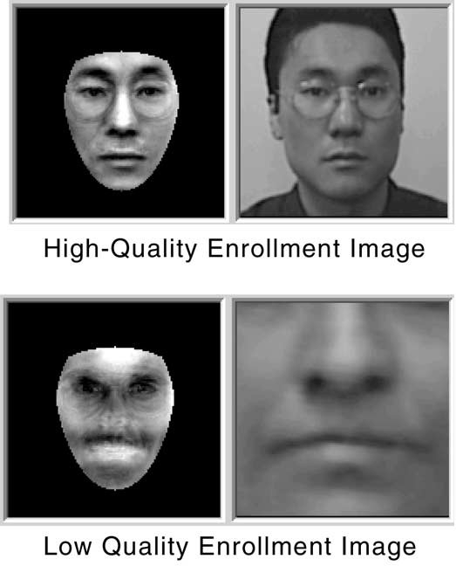
Image acquisition
Facial-scan technology can acquire faces from almost any static camera or video system that generates images of sufficient quality and resolution.
High-quality enrollment is essential to eventual verification and identification enrollment images define the facial characteristics to be used in all future authentication events.

Slide 10
Image Processing
Images are cropped such that the ovoid facial image remains, and color images are normally converted to black and white in order to facilitate initial comparisons based on grayscale characteristics.
First the presence of faces or face in a scene must be detected. Once the face is detected, it must be localized and Normalization process may be required to bring the dimensions of the live facial sample in alignment with the one on the template.

Slide 11
Distinctive characteristic location
All facial-scan systems attempt to match visible facial features in a fashion similar to the way people recognize one another.
The features most often utilized in facial-scan systems are those least likely to change significantly over time: upper ridges of the eye sockets, areas around the cheekbones, sides of the mouth, nose shape, and the position of major features relative to each other.
Behavioral changes such as alteration of hairstyle, changes in makeup, growing or shaving facial hair, adding or removing eyeglasses are behaviors that impact the ability of facial-scan systems to locate distinctive features, facial-scan systems are not yet developed to the point where they can overcome such variables.

Slide 12
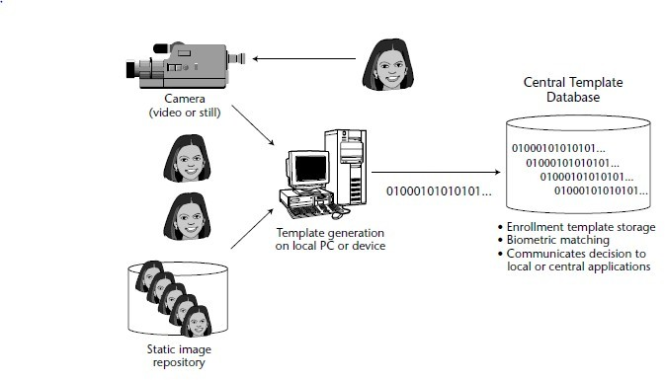
Template creation

Slide 13

Template matching
It compares match templates against enrollment templates.
A series of images is acquired and scored against the enrollment, so that a user attempting 1:1 verification within a facial-scan system may have 10 to 20 match attempts take place within 1 to 2 seconds.
Facial-scan is not as effective as finger-scan or iris- scan in identifying a single individual from a large database, a number of potential matches are generally returned after large-scale facial-scan identification searches.

Slide 14

How this system work
Facial recognition software is based on the ability to first recognize faces, which is a technological feat in itself. If you look at the mirror, you can see that your face has certain distinguishable landmarks. These are the peaks and valleys that make up the different facial features.
VISIONICS defines these landmarks as nodal points. There are about 80 nodal points on a human face.

Slide 15
Here are few nodal points that are measured by the software.
Distance between the eyes
Width of the nose
Depth of the eye socket
Cheekbones
Jaw line
Chin

Slide 16
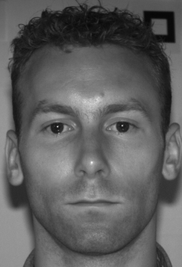
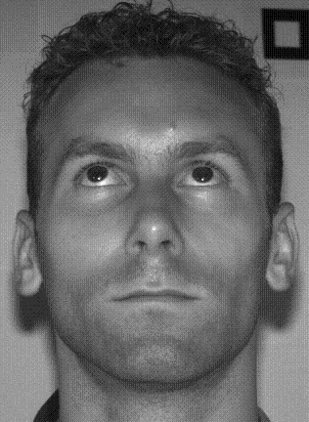

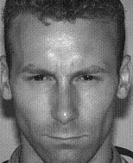

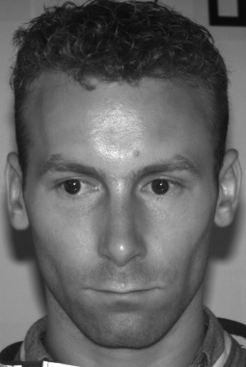
Limitations of 2D Face Recognition
System effectiveness is highly dependant on image capture conditions.
Lighting conditions.
Different lighting conditions for enrolment and query.
Bright light causing image saturation.
Head orientation.
2D feature distances appear to distort.
Image quality.
CCTV, Web-cams etc.
Facial expression.
Changes in feature location and shape.
Partial occlusion
Hats, scarves, glasses etc.
Face recognition is not as accurate as other biometrics.
Error rates that are too high for many applications in mind.
Result:

Slide 17
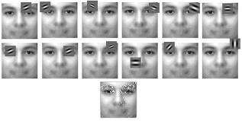
3D FACIAL RECOGNITION
Emerging trend in facial recognition software using a 3D model which provide more accuracy.
It can even be used in darkness and has the ability to recognize a subject at different view angles.
Using 3D software ,the system goes through a series of steps to verify the identity of an individual.

Slide 18
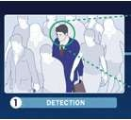
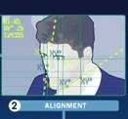
WORKING
Acquiring an image can be accomplished by digitally scanning device.
Once it detects a face, the system determines the head’s position, size and pose.

Slide 19
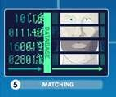
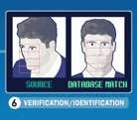
If the image is 3D and the database contains 3D images, then matching will take place without any changes being made to the image.
In verification, an image is matched to only one image in the database.

Slide 20
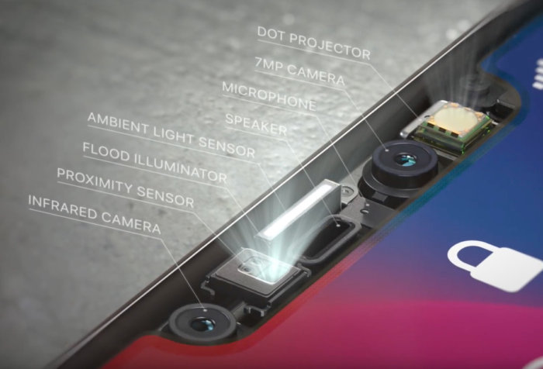
EXAMPLE:

Slide 21

Software
Detection- when the system is attached to a video surveillance system, the recognition software searches the field of view of a video camera for faces. If there is a face in the view, it is detected within a fraction of a second. A multi-scale algorithm is used to search for faces in low resolution. The system switches to a high- resolution search only after a head-like shape is detected.
Alignment- Once a face is detected, the system determines the head's position, size and pose. A face needs to be turned at least 35 degrees toward the camera for the system to register it.

Slide 22
Normalization-The image of the head is scaled and rotated so that it can be registered and mapped into an appropriate size and pose. Normalization is performed regardless of the head's location and distance from the camera. Light does not impact the normalization process.
Representation-The system translates the facial data into a unique code. This coding process allows for easier comparison
of the newly acquired facial data to stored facial data.
Matching- The newly acquired facial data is compared to the stored data and (ideally) linked to at least one stored facial representation.

Slide 23

Advantages
Security levels will be significantly improved
The integration process is easy and flawless
High accuracy allows avoiding false identification
Facial Recognition System is fully automated
Time fraud will be excluded

Slide 24
Disadvantages
Difficulties with data processing and storing
Troubles with images size and quality
Strong influence of the camera angle

Slide 25
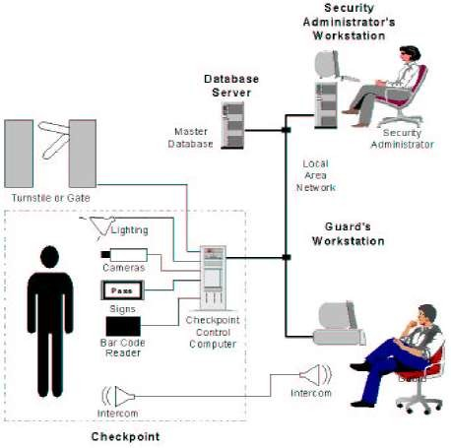
APPLICATIONS OF FACE RECOGNITION TECHNOLOGY
Multimedia Management
Security
Face ID
HCI - Human Computer Interaction
Law Enforcement

Slide 26

Conclusion
Factors such as environmental changes and mild changes in appearance impact the technology to a greater degree than many expect.
For implementations where the biometric system must verify and identify users reliably over time, facial scan can be a very difficult, but not impossible, technology to implement successfully.

Slide 27
R e f e r e n c e s
www.Biometricgroup.com/wiley
Biometrics- identify verification in a networked world by Samir Nanavati, Micheal Thieme and Raj Nanavati.
History- www.Biometrics.gov.

Slide 28
Thank you

